Slide 1


Recurrent Neural Network Modeling of Metal Commodity Pricing
DATS 6501: Capstone Design
Author: Rich Gude, M.S.

Slide 2
Outline
Commodities Introduction
Study Purpose
Price and Economic Feature Data
ARIMA/Random Walk Model
Recurrent Neural Network Model
Key Findings
Conclusion

Slide 3
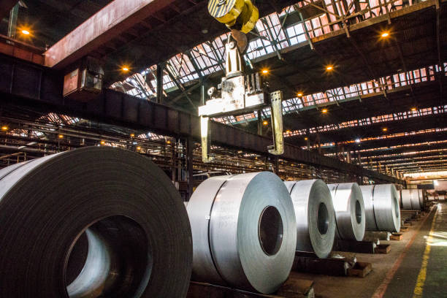

Commodities Introduction
Unaffiliated Project
Author background in alloy procurement for large military vendors
Vendors procure large alloy ingots:
Stainless Steel (80%wt-Fe, 13%wt-Cr, +)
Alloy 600 (72%Ni, 16%Cr, 8%Fe, +)
Monel (63%Ni, 30%Cu, 2%Fe, +)
Industry need for predicting appropriate time to procure alloy-constituent metals

Slide 4
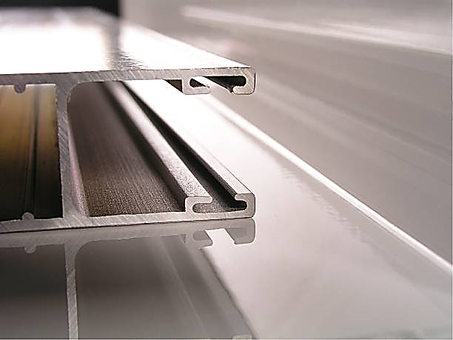
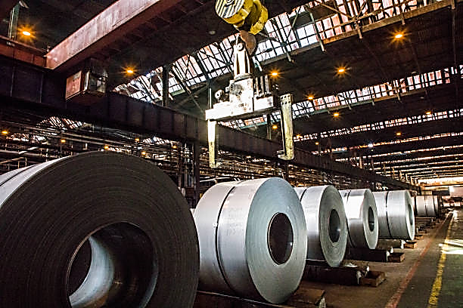
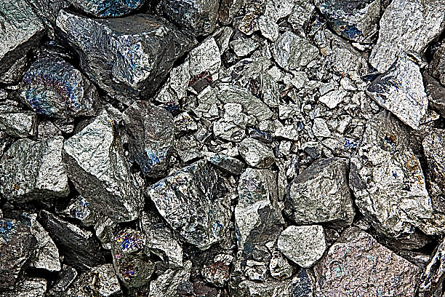
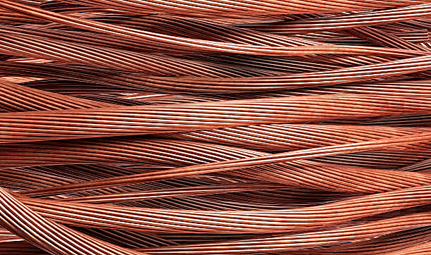

Industrial Commodities Background
Aluminum
low-weight, corrosion-resistant
Common in transportation and construction industries, minor alloying element
Second-most produced/consumed metal commodity after iron/steel.
Copper
Malleable and highly conductive
Common in electrical generation/distro
Unique marine properties
Iron/Steel
Chemical composition and thermal treatment drastically alter steel properties
Billions of metric tons produced annually
Nickel
Exceptional corrosion resistant
Large alloying element, battery uses
Zinc
Unique corrosion properties
Large alloying and coating element

Slide 5

STUDY PURPOSE
Real World Problem: Commodities markets are volatile; ability to predict price fluctuations, identifying minimum prices ideal for buying industrial stock, would improve product profit and market performance.
Current literature methods have explored regression of economic features and technical trade rules; diverse background of machine learning studies are lacking
Machine learning models suited for time-series data, Recurrent Neural Networks, are potential area for further study

Slide 6
Study Goals
Explore Recurrent Neural Network (RNN) models for improvement over current methods
If applicable, use improved model to generate API for alloy price model creation

Slide 7
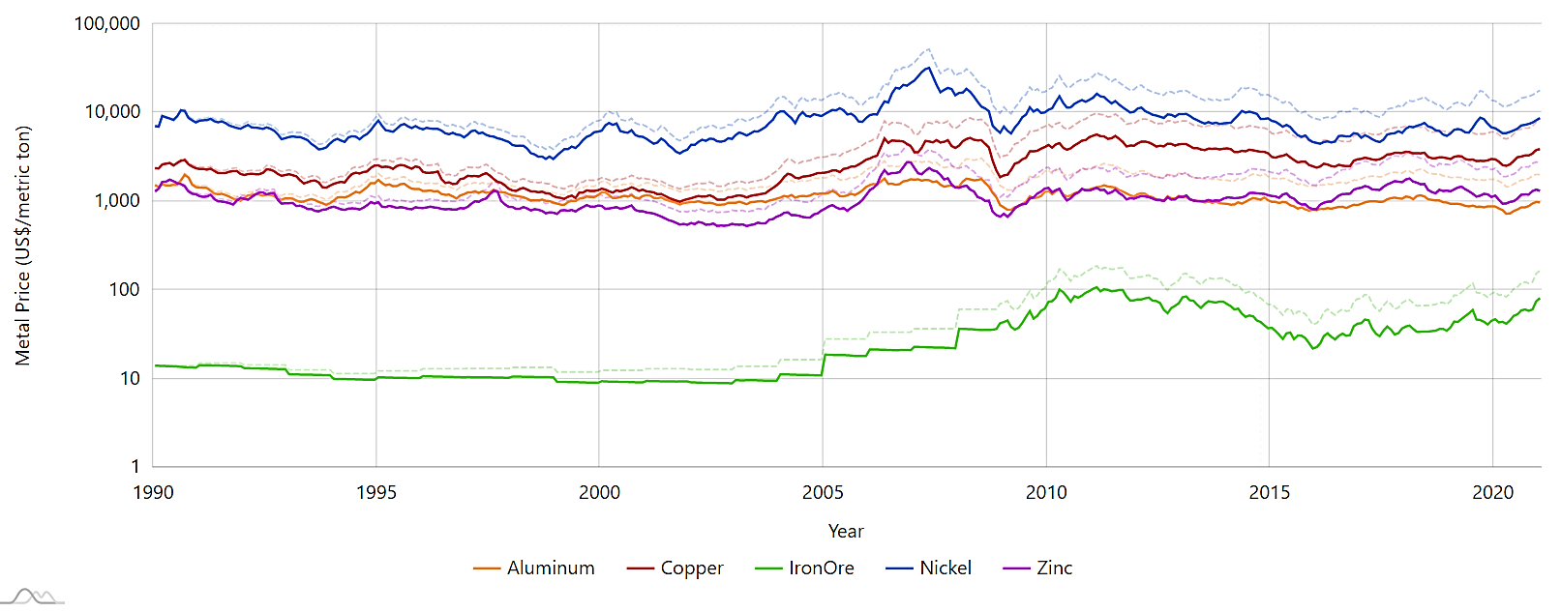
Price Data
Standout: Large Difference in Price between Commodities
Commodity Price data for Aluminum, Copper, Iron Ore, Nickel, and Zinc originate from International Monetary Fund (IMF)
Monthly from Jan 1990 to Dec 2020
Commodity price (US$/metric ton) altered to jan-1990-equivalent, ‘real’ price utilizing ratio of Consumer Price Index (CPI) between each month and Jan-1990.

Slide 8
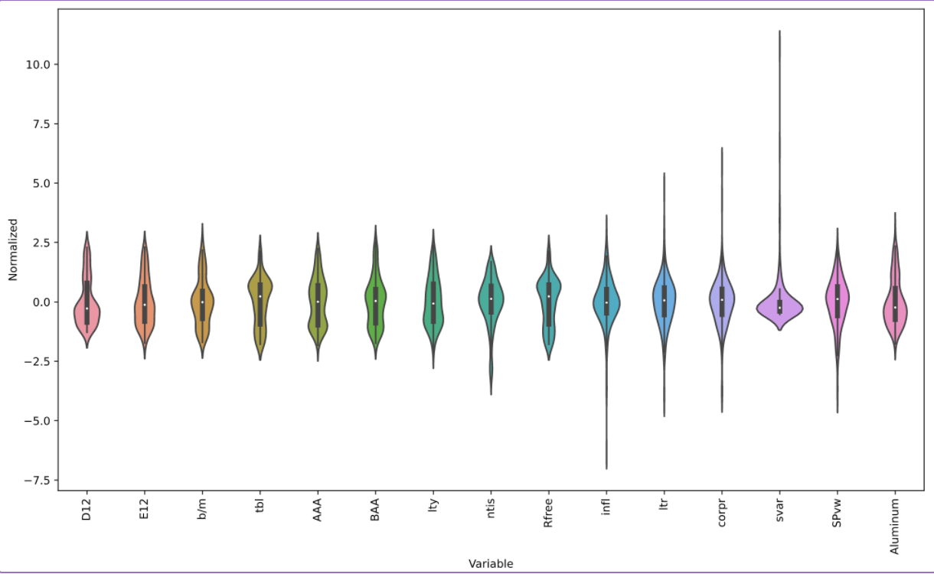
Economic Feature Data
Welch and Goyal evaluate 14 variables, collected monthly from Jan-1990 to Dec-2020, utilized herein:
D12/E12: S&P 500 12-month moving sums of dividends and earnings;
b/m: the book-to-market value ratio of the DJIA
tbl: the 3-month treasury billrate
AAA/BAA: AAA and BAA-rated bond yields
lty: long-term government bond yields
ntis: the net equity expansion from the NYSE
Rfree: risk-free rate
infl: inflation
ltr/copr: long-term gov. and corporate bond returns
svar: S&P 500 daily stock variance
SPvw: S&P 500 index prices
Violin Plot showing EF distributions

Slide 9
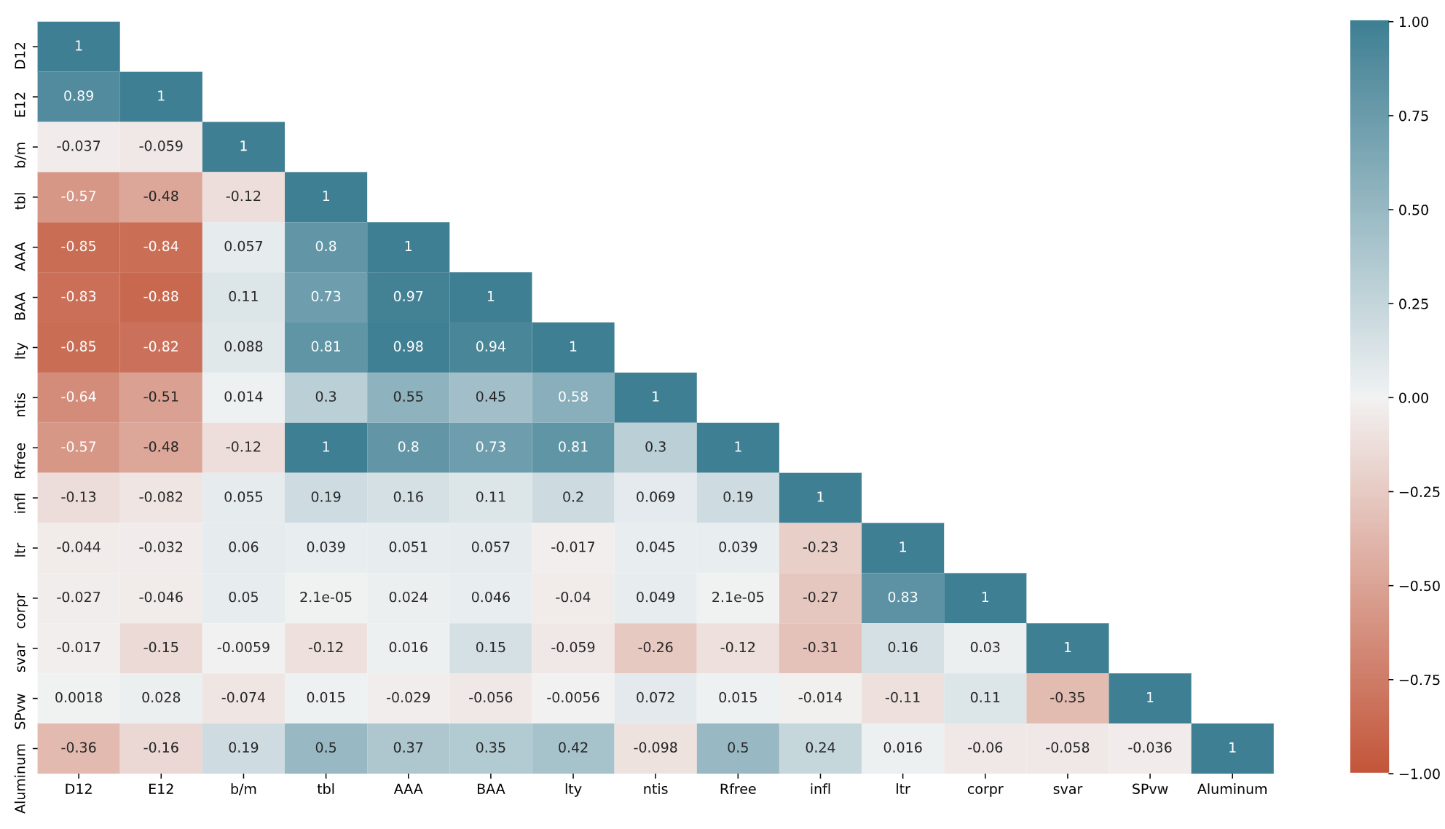
Economic Feature Correlation
No economic feature has more than a moderate correlation (roughly ±0.5) with aluminum price
Other features are highly correlated (> 0.9) and can be excluded from model creation:
Treasury bill rate (tbl) <-> Risk-free Rate (Rfree)
S&P 500 Dividends (D12) <-> and Earnings (E12)
AAA <-> BAA <-> long-term government (ltr) bond yields
No need for more than 10 econometric features in each model

Slide 10
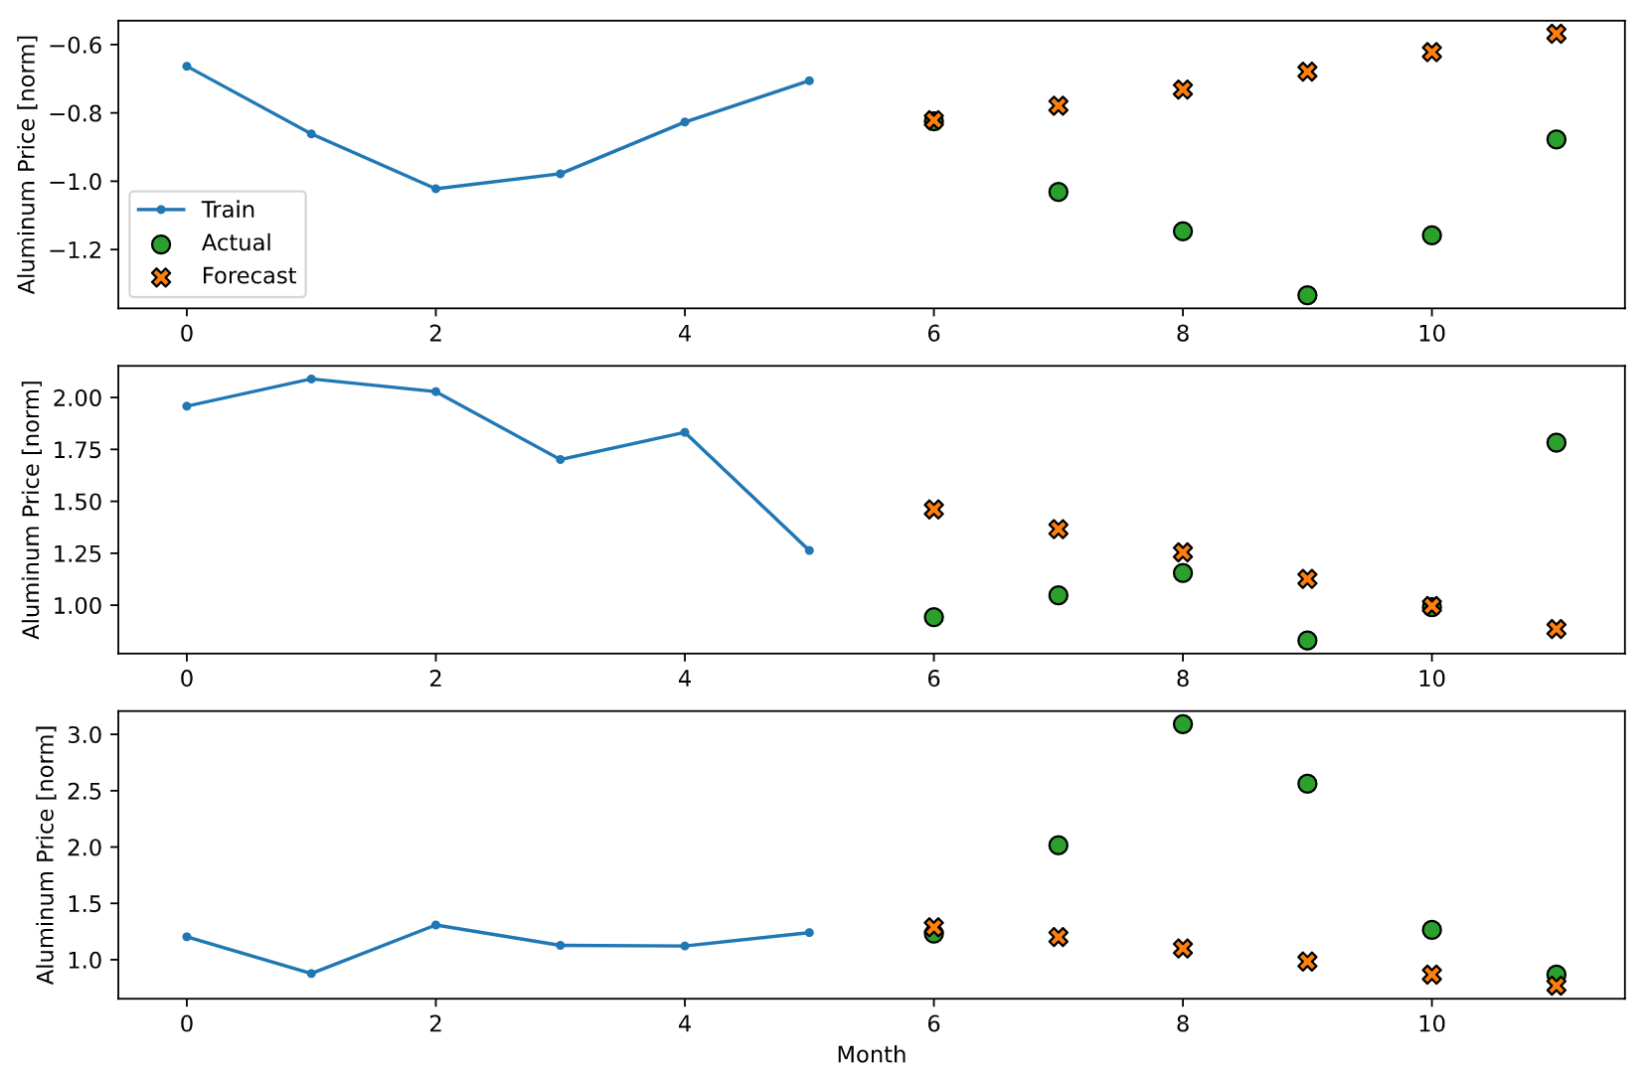
Research Methodogy
RNN and autoregressive commodity price models developed from six (6) months of previous price and/or economic feature data to forecast commodity price predictions out to six (6) months in the future.
162 forecasted prices
Mean Square Error (MSE) will evaluate efficacy of models

Slide 11
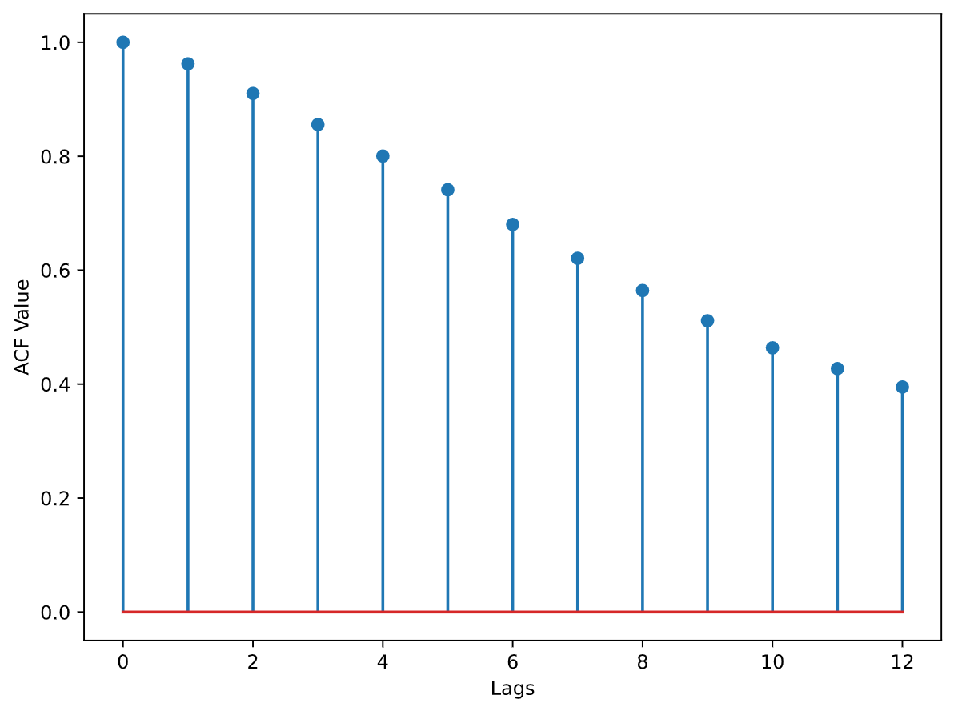
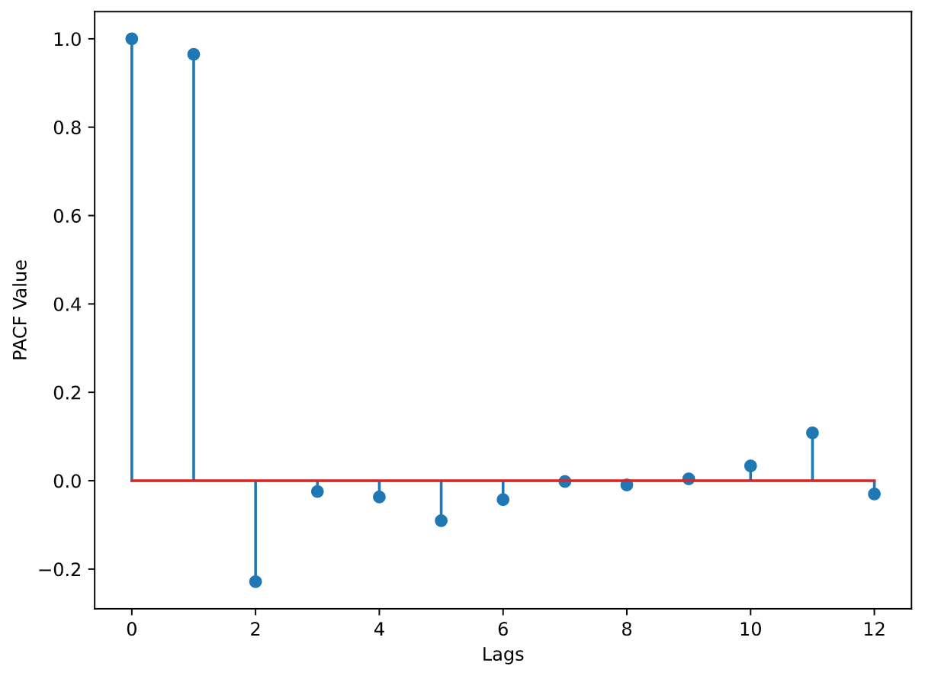
ARIMA Modeling
Evaluation of Autocorrelation and Partial Autocorrelation Function values determining model differencing (i.e., Difference Order, Q, of 1)
Python ‘statsmodels.tsa’ libraries for deriving ARIMA model coefficients confirms Autoregressive and Moving Average Order of 0 each.
Accordingly, ARIMA model for each commodity is: ARIMA(0,1,0) – a random walk

Slide 12
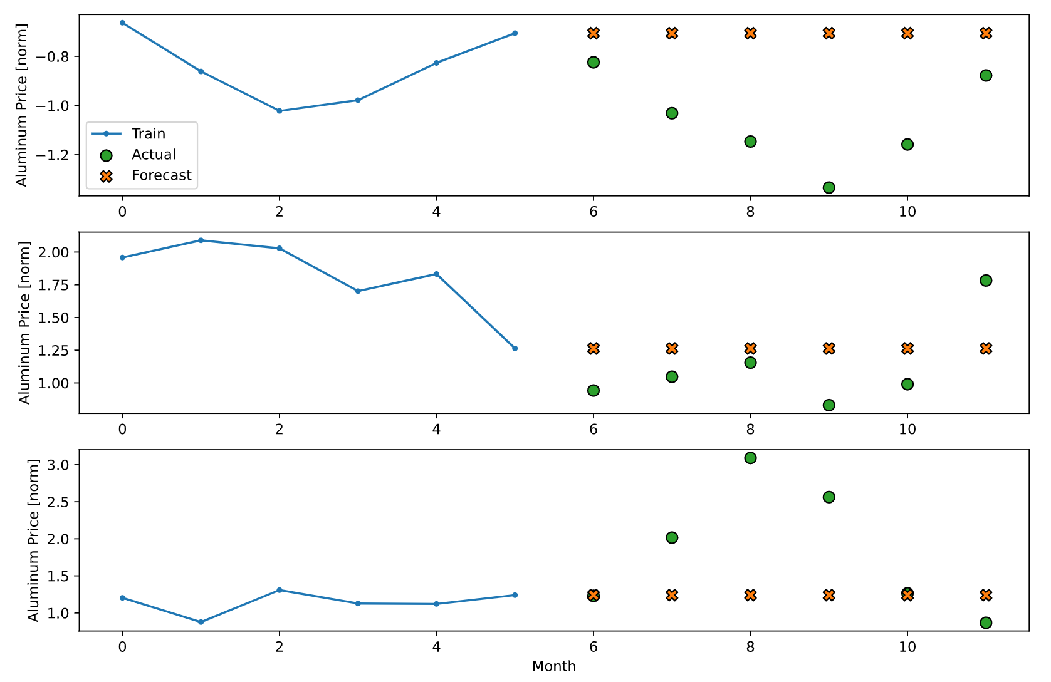
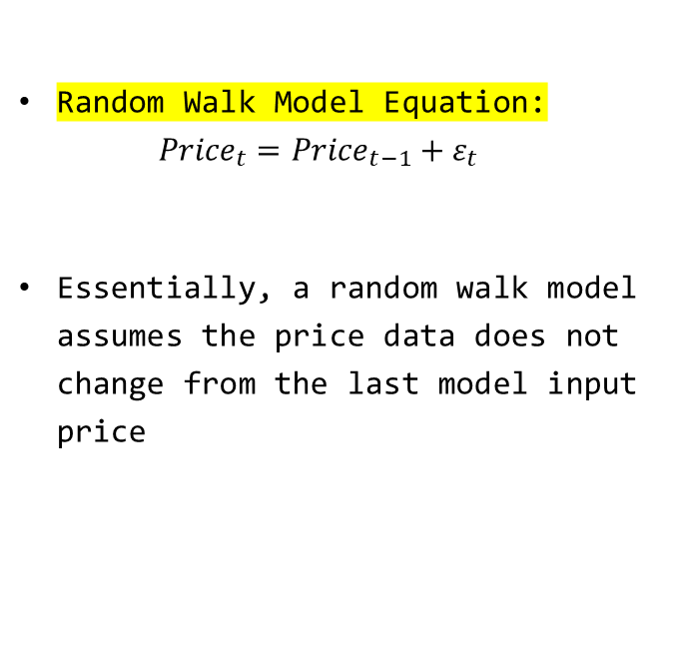
Random Walk Model
Random Walk Model Equation:
$${Price}_{t}={Price}_{t−1}+ε_{t}$$
Essentially, a random walk model assumes the price data does not change from the last model input price

Slide 13
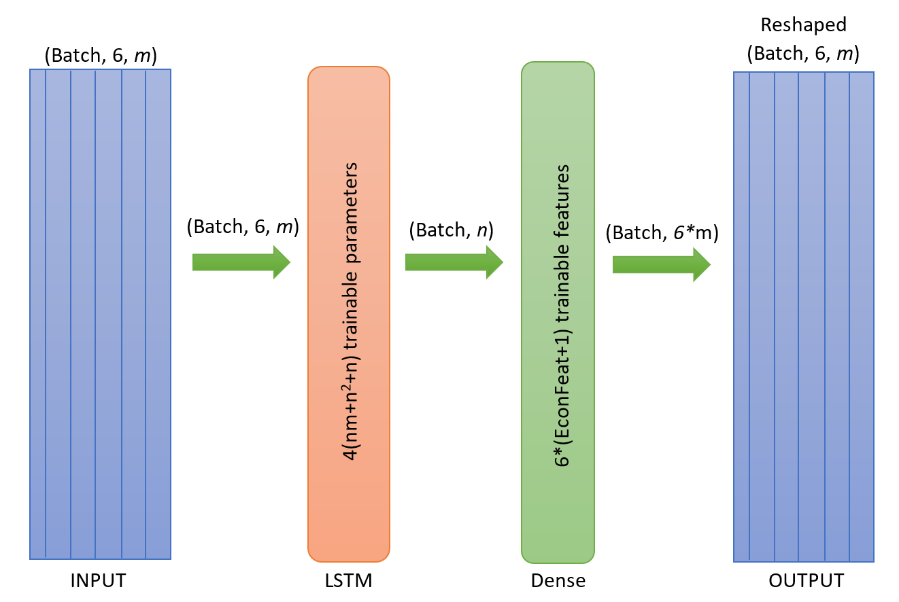
Recurrent Neural Network (RNN)
The Recurrent Neural Networks (RNNs) used in model building were Keras-based Long Short-Term Memory (LSTM) layers from the TensorFlow Python library.

Slide 14
3 RNN Models Considered
With 10 economic features and commodity price, there are thousands of potential combinations of variables for model creation
Curse of Dimensionality would give little confidence in any such models produced therein…
Instead, 3 Models are considered for each commodity:
RNN_1:
All 10 non-correlated economic features (D12, b/m, tbl, AAA, ntis, infl, ltr, corpr, svar, SPvw) and the real commodity price.
RRN_2:
The economic features with at least ±0.3 correlation with each real commodity price and the real commodity price:
Aluminum: D12, tbl, lty
Copper/Iron Ore: E12, b/m, tbl, AAA, ntis
Nickel/Zinc: E12, ntis
RRN_3:
Just the real commodity price

Slide 15
RNN_3 Model

Slide 16
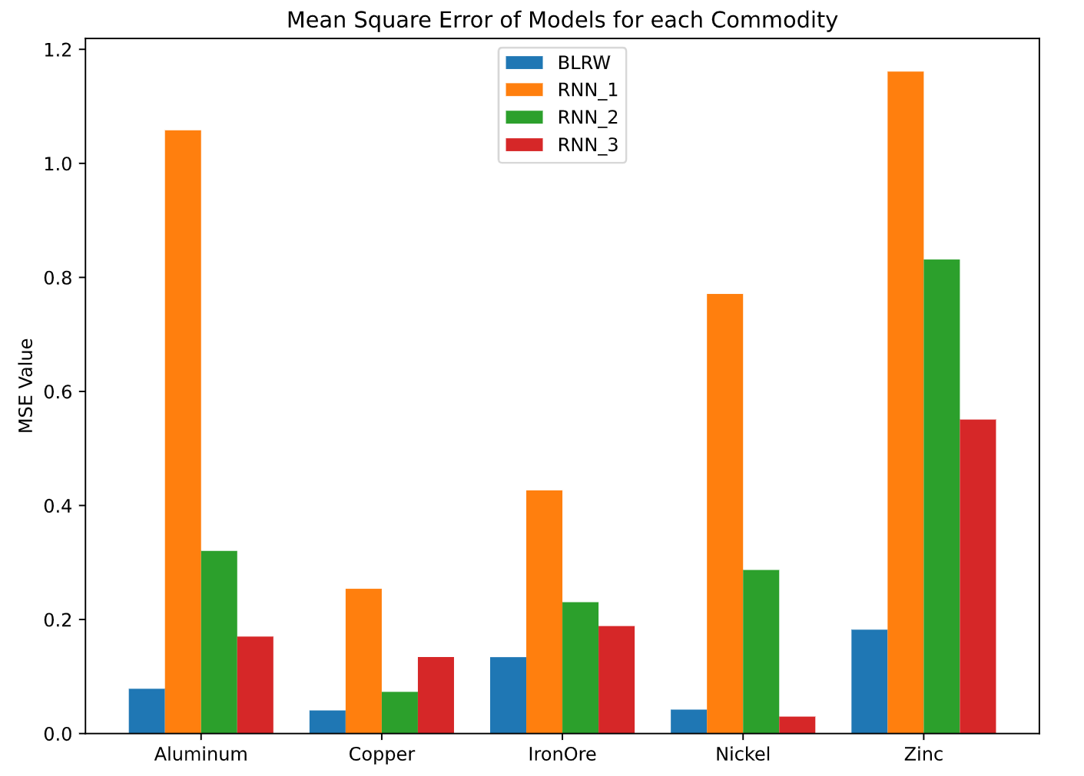
Key Findings
Commodity economic feature data had a deleterious effect on recurrent neural network model performance
RNN_3 MSE < RNN_2 MSE < RNN_1 MSE
The baseline random walk model performed better than all RNN models for four out of five commodities.
Two-sample t-test calculations comparing the means of the baseline random walk and RNN_3 models confirm results

Slide 17
Project Conclusions: Goal 1
This study sought to add to the literature of machine learning techniques for forecasting commodities prices by investigating the efficacy of Recurrent Neural Networks (RNNs)
Autoregressive analysis for each set of commodity data identified a random walk trend (i.e., an ARIMA(0,1,0) model with no trend constant) for each.
With three (3) RNN models derived for each commodity utilizing different combinations of correlated economic features, RNN models were not found to be superior for forecasting commodity prices over a random walk method
Only one (1) RNN model out of fifteen (15) was statistically superior to a random walk model with nickel prices utilizing no economic feature data.
Testing suggests that the fundamental nature of industrial commodity data is a random walk model.

Slide 18

Project Conclusion: Goal 2
“If applicable, use improved model to generate API for alloy price model creation”
Based on the Key Findings showing that a random walk model (i.e., a constant price data trend) is superior to any RNN model, an API for alloy price model creation would not be significantly advantageous.
Any such predictive model would show that any time in the next 6 months (including immediately) would be the ideal time for metal procurement.

Slide 19

Questions?
About the Author:
Graduate student in the George Washington University, Columbian School of Arts and Sciences, Data Science Program
Background is in advanced materials research, including carbon nanotube battery configurations and metal alloy testing and development within military and civilian consulting positions for the past 8 years
Personal interests include perfecting his household outdoor grilling space and volleyball.

